Slide 1

INSTITUTE :UIE
DEPARTMENT: ALL ACADEMIC UNITS
Bachelor of Engineering (All Sections)
Subject Name and Code:
Engineering Physics 23SPH-141
Prepared by: Anu Kapoor, Assistant Prof. Physics
LASER
DISCOVER . LEARN . EMPOWER

Slide 2
COURSE OBJECTIVES
The course is designed to make the students industry ready to contribute in the growing demand of the industry at local, national and international level.
It will make the students competent to understand basic concepts and applications of advanced engineering physics and apply its principles in their respective fields at global platform.
It will enhance the skill level of the students and shall make them preferred choice for getting employment in industry and research labs.
It will give thorough knowledge of the discipline to enable students to disseminate knowledge in pursuing excellence in academic areas.

Slide 3

COURSE OUTCOMES
CO Number | Title On completion of this course, the students are expected to learn | Level
CO1 | Quote the basic fundamental concepts of lasers, optical fibres, crystallography, ultrasonic oscillations, semiconductor physics, quantum mechanics and nanotechnology. | Remember, Understand
CO2 | Demonstrate the working of various lasers, fibre components, semiconductor devices; explain the behaviour of crystalline solids, quantum and nano-scale systems. | Understand
CO3 | Solve problems by applying principles related to lasers, fibres, semiconductors, oscillations, quantum and nanoscience. | Applying
CO4 | Compare various lasers and fibres, semiconducting devices, crystalline materials, structures at quantum and nanoscale on the basis of their properties for industrial applications. | Analyze
CO5 | Develop various systems using lasers, fibres, semiconductors and nanomaterials for futuristic applications. | Design
Fig. 1 Introduction [1]

Slide 4

“ In the War of Worlds, written before the turn of 20th century, HG Wells told a fanciful story of how Martians invaded and almost conquered the earth. Their weapon was a mysterious sword of heat, from which flickered a ghost of a beam of light. It felled men in their tracks, made lead run like water and flashed anything combustible into masses of flame. Today Well’s word of heat comes close to reality in the laser…………”
Fig. 2 Introduction [2]

Slide 5

WHY TO STUDY LASER
Offering a high-speed way to process various materials, lasers are being used on a large scale in various industries.
Innovative technologies are driving the growth of industrial lasers. Manufacturers are introducing technologically advanced industrial lasers for various applications.
The global industrial laser market is highly dynamic, and growing at a fast pace.
The increasing innovations taking place in fiber lasers play an important role in the growth of the global industrial laser market
https://www.youtube.com/watch?v=_yLfLDHBUak[3]

Slide 6

CONTENT TO BE DISCUSSED….
Ruby laser
Construction
Working
Applications
Fig. 3 Introduction [4]

Slide 7
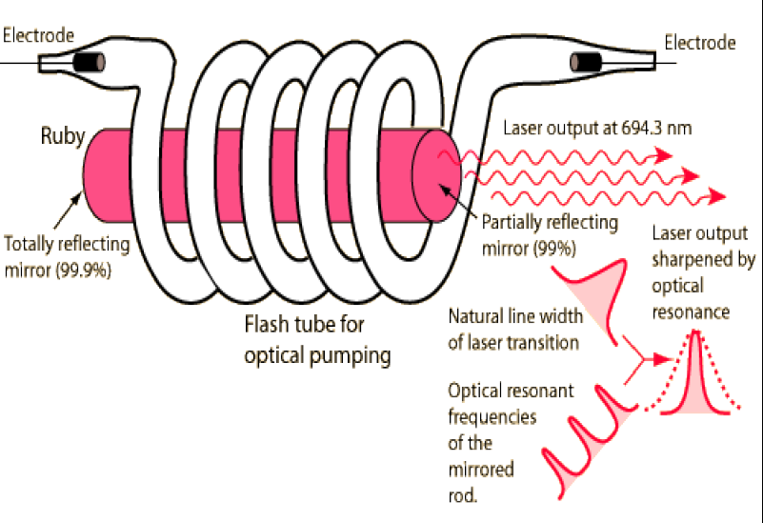
RUBY LASER
Solid State laser
Optical discharge pumping technique
Chromium ions are active centers
Emits light in visible region
Figure 4 Ruby Laser [11]

Slide 8
RUBY LASER
Principle features
Type : Doped Insulator Laser
Active Medium : Ruby crystal( Aluminium oxide + Chromium Oxide)
Active Centre : Cr³⁺ ions
Pumping Method Optical Pumping
Pumping Source : Xenon Flash Pump
Optical Resonator Ends of rods silver coated partially and totally reflecting
Nature of Output Pulsed
Wavelength Emitted 694.3 nm

Slide 9
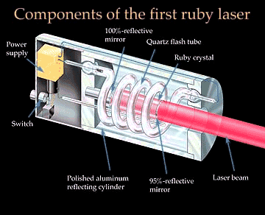
CONSTRUCTION
Figure 5 Ruby Laser [11]

Slide 10
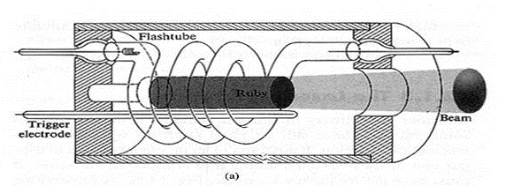
CONSTRUCTION
In ruby laser 4 cm length and 5 mm diameter rod is generally used.
Both the ends of the rods are highly polished and made strictly parallel. The ends are silvered in such a way, one becomes partially reflected and the other end fully reflected.
The ruby rod is surrounded by xenon flash tube, which provides the pumping light to excite the chromium ions in to upper energy levels.
Figure 6 Ruby Laser [12]

Slide 11
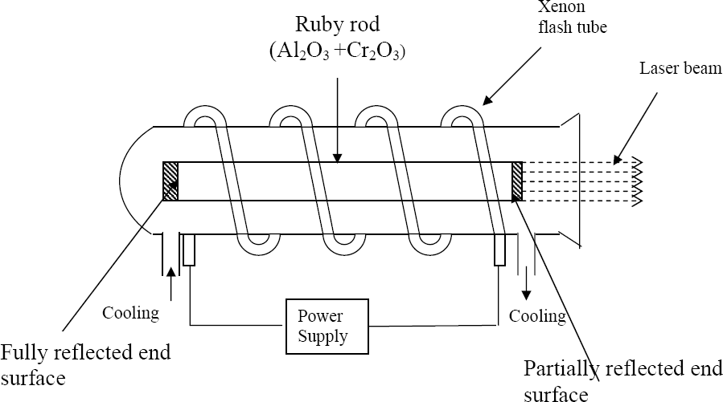
CONSTRUCTION
Xenon flash tube emits thousands joules of energy in few milli seconds, but only a part of that energy is utilized by the chromium ions while the rest energy heats up the apparatus.
A cooling arrangement is provided to keep the experimental set up at normal temperatures
Figure 7 Ruby Laser [13]

Slide 12
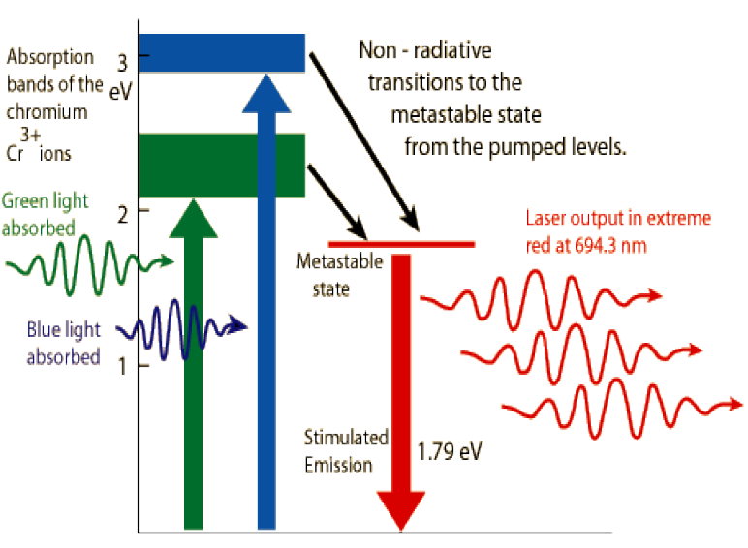
WORKING OF RUBY LASER
Ruby crystal is surrounded by xenon tube. Ruby crystal is fully silvered at one side and partially silvered at the other end.
A strong beam of blue green light is made to fall up on crystal from xenon tube and this light is absorbed by the crystal.
Because of this, many electrons from ground state or normal state are raised to the excited state or higher state and electron falls to meta-stable state.
Figure 8 Ruby Laser [14]

Slide 13
WORKING OF RUBY LASER
During this transition photon is not emitted but excess energy of the electrons absorbed in crystal lattice.
As electron drops to meta-stable state they remain there for certain time ~ 10⁻⁶ sec.
Thus the incident blue green light from tube increases the number of electron in meta-stable state and then the population inversion can be achieved.
If a light of different frequency is allowed to fall on this material, the electrons move back and forth between silvered ends of the crystal.
While moving through they get stimulated and excited electrons radiate energy.
Thus released photon has the same frequency as that of incident photon and is also in exactly same phase.
When the intensity of light beam is increased the same process is repeated.

Slide 14
WORKING OF RUBY LASER
Thus released photon has the same frequency as that of incident photon and is also in exactly same phase.
When the intensity of light beam is increased the same process is repeated.
Finally extremely intensified beam of light energies from the semi silvered side of the crystal.
This way it is possible to get extremely intensified and coherent beam of light from the crystal. This beam is nothing but higher energetic beam – i.e. LASER beam.

Slide 15
RUBY LASER OUTPUT
Three level laser
Solid laser
Output wavelength- 694.3 nm

Slide 16
APPLICATIONS
Ruby lasers are used in a number of applications where short pulses of red light are required. Holography around the world produce holographic portraits with ruby lasers, in sizes up to a meter squared.
Many non-destructive testing labs use ruby lasers to create holograms of large objects such as aircraft to look for weaknesses in the lining.
Ruby lasers are used extensively in tattoo and hair removal.
Ruby lasers can be used for measurement of plasma properties such as electron density and temperature.
Ruby lasers are used to remove the melanin of the skin.

Slide 17
SUMMARY
Ruby laser
Construction
Working
Applications

Slide 18
REFERENCES
[1] http://news.mit.edu/2018/laser-attract-alien-astronomers-study-1105
[2] https://www.gutenberg.org/files/36/36-h/36-h.htm
[3] https://www.youtube.com/watch?v=_yLfLDHBUak
[4] stockphoto.com/in/vector/abstract-red-laser-beam-transparent-isolated-on-black-background-vector-illustration-gm1048453908-280444377
[5] https://www.physics-and-radio-electronics.com/blog/absorption-of-radiation-spontaneous-emission-and-stimulated-emission/
[6] https://users.aber.ac.uk/ruw/teach/327/spec.php
[7] https://www.convergentlaser.com/laser-safety
[8] http://www.hk-phy.org/articles/laser/3-states_e.gif
[9] https://www.mcgill.ca/ehs/laboratory/laser-safety/laser-safety-manual/appendices
[10]http://www.laserfest.org/lasers/how/ruby.cfm
[11] http://hyperphysics.phy-astr.gsu.edu/hbase/optmod/lassol.html
[12] https://sites.google.com/site/puenggphysics/home/unit-i/ruby-laser

Slide 19
REFERENCES
[13]https://www.google.com/url?sa=i&url=https%3A%2F%2Fwww.eatm.in%2Fupload%2Fsrit__unit_i_laser.pdf&psig=AOvVaw2uJB6qsMMkF0YF5eo1pPDP&ust=1596105968506000&source=images&cd=vfe&ved=0CAIQjRxqFwoTCMibo6Gk8uoCFQAAAAAdAAAAABAQ
[14] https://sites.google.com/site/puenggphysics/home/unit-i/ruby-laser

Slide 20
THANK YOU
anukapoor.appsci@cumail.in

